Slide 1
AWS Security Services

Slide 2
Agenda
Introduction to AWS Security Services
IAM
KMS
Secrets Manager
VPC Network Security Features
EMR Security
Redshift Security

Slide 3
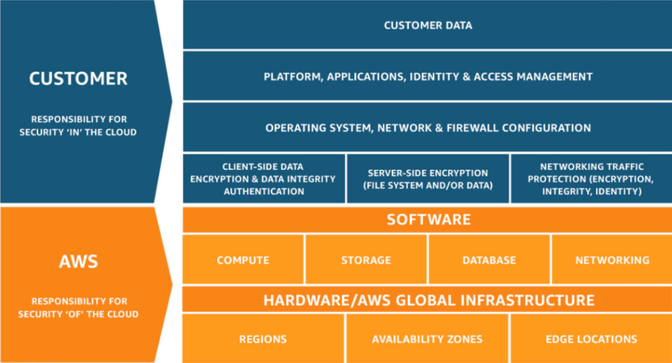
Introduction to AWS security services
The AWS infrastructure is designed to be one of the most flexible and secured cloud computing environments which are attainable today.
It is designed to provide a highly scalable and reliable platform that allows customers to deliver applications and data quickly and securely.
AWS uses redundant, layered controls, continuous validation and testing, and critical levels of automation to ensure that your underlying infrastructure is monitored and protected 24/7. To do
All AWS customers benefit from a data center and network architecture designed to meet the needs of their most security-sensitive customers.
Credit: https://docs.aws.amazon.com/whitepapers/latest/introduction-aws-security/security-of-the-aws-infrastructure.html
Notes:
Reference for contents : https://docs.aws.amazon.com/whitepapers/latest/introduction-aws-security/security-of-the-aws-infrastructure.html
More explanation: AWS works with the shared security responsibility model. AWS is responsible for the security of the underlying cloud infrastructure and you are responsible for protecting the workload you deploy to AWS.

Slide 4
Security products and features
AWS provides security-specific tools and capabilities for network security, configuration management, access control, and data security. It include:
Network firewall: Built into your Amazon VPC to create a private network and control access to your instances or applications. Customers can use TLS to control encryption in transit across AWS services.
Connectivity: Allow private or dedicated connections from the office or local area.
Automatic encryption of all traffic on AWS global and regional networks between secure AWS facilities.
Deployment tool: Control the advent and decommissioning of AWS sources in line with business enterprise standards.
Saved data encryption features: Amazon EBS, Amazon S3, Amazon RDS, Amazon Redshift, Amazon ElastiCache, AWS Lambda, and Amazon SageMaker .
Encrypted message queue: To send sensitive data using Amazon SQS server-side encryption (SSE)
Notes:
Reference for contents : https://docs.aws.amazon.com/whitepapers/latest/introduction-aws-security/security-of-the-aws-infrastructure.html
More explanation: Amazon CloudWatch: Provides a reliable, scalable and flexible monitoring solution that can run in minutes
Amazon GaurdDuty: Threat detection service

Slide 5
Security Guidance
AWS provides customers with guidance and expertise through tools, resources, online support, and professional services offered by AWS and its partners:
AWS Trusted Advisor: An online tool that acts like a bespoke cloud expert to help you configure your resources to follow best practices.
AWS Account Teams: Gives direction towards the correct resource to resolve the security problems that is encountered.
AWS Enterprise support: It offers a 15-minute response time and is available 24 hours a day, 7 days a week by phone, chat, or email. With a dedicated technical account manager
AWS partner Network: Offers hundreds of industry leading products
AWS Professional Service: Assist customers in developing security policies and practices based on proven designs to ensure that their security designs meet internal and external compliance requirements.
Notes:
Reference for contents : https://docs.aws.amazon.com/whitepapers/latest/introduction-aws-security/security-of-the-aws-infrastructure.html
More explanation: AWS Market Place: A software vendor that makes it easy to find, test, buy, and deploy software running on AWS.
AWS Security Bulletins: Provides security bulletins around existing threats.
AWS WellArchitected Framework: Helps cloud architects build secure, high-performance, resilient and efficient infrastructure for their applications.

Slide 6
Identity and Access Management (IAM)
IAM allows you to define individual user accounts that have permissions to AWS resources AWS Multi-System Authentication for privileged accounts, including options for hardware and software validators.
It can be utilized to allow your employees and applications a federated access to the AWS management consol and AWS service APIs.
AWS Identity and Access Management (IAM) provides granular access control across AWS.
Using IAM, you can specify who can access which services and resources, and under what conditions.
IAM service is used at free of charge.
IAM Features:
Shared access to the AWS account
Granular permissions
Multifactor authentication
Notes:
Reference for contents : https://docs.aws.amazon.com/IAM/latest/UserGuide/intro-structure.html
More explanation: More features
Identity federation
Identity information for assurance
Free to use
Integrated with many AWS service

Slide 7
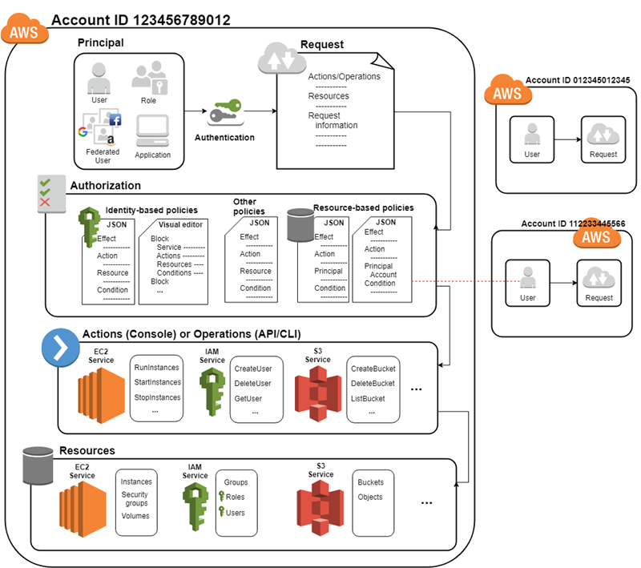
How IAM Works:
1. Terms:
IAM resource: Edit/remove resource from IAM
IAM Identity: Attach a policy to IAM identity
IAM entities: Used by AWS for authentication
Principals: Includes federated users and assumed roles
2. Principal: Used to request for action in AWS resource.
3. Request:
Actions: Operations that principal wants to perform
Resource: Resource object upon which actions are performed
Credit: https://docs.aws.amazon.com/IAM/latest/UserGuide/intro-structure.html
Notes:
Reference for contents : https://docs.aws.amazon.com/IAM/latest/UserGuide/intro-structure.html
More explanation:
Principals: Person/application that utilized entity to send request
Environment data: Information about IP address and user agent
Resource data: Information related to resource being requested
4. Authentication: Principal must be authenticated to send request
5. Authorization: Person must be authorized to send a request

Slide 8
Accessing IAM:
AWS Management Console: browser-based interface for managing IAM and AWS resources
AWS Command Line Tools: To difficulty instructions at your system`s command line to carry out IAM and AWS tasks.
There are two types of command ;line interface:
1. AWS Command Line Interface
2. AWS Tools for Windows PowerShell
AWS SDKs: AWS provides SDKs that stands for Software Development Kits. It consists of libraries and sevral sample code for different programming languages like JAVA, Python, Ruby, IOS, Android, .NET etc.
The SDK provides a convenient way to programmatically create access to IAM and AWS.
IAM HTTPS API: It allows user to access IAM and AWS programmatically by using IAM HTTPS API and HTTPS request can be issued automatically to the service.
Notes:
Reference for contents : https://docs.aws.amazon.com/IAM/latest/UserGuide/intro-structure.html
More explanation:

Slide 9
Key Management Service (KMS)
Overview:
You can use the AWS Key Management Service (KMS) to centrally manage the encryption keys used to protect your data.
AWS KMS allows developers to easily add encryption or digital signature capabilities to their application code, either directly or using the AWS SDKs.
The AWS Encryption SDK supports AWS KMS as a root key provider for developers who need to encrypt / decrypt data locally in their applications.
Centralized Key Management:
AWS KMS allows you to centrally manage your key lifecycle and permissions.
You can create new keys at any time and control who can manage the keys and who can use them.
Instead of using the keys generated by AWS KMS, you can either import the keys from your own key management infrastructure or use the keys stored in your AWS CloudHSM cluster.
Notes:
Reference for contents : https://aws.amazon.com/kms/
More explanation: You can choose to automatically rotate the AWS KMS-generated root key once a year without re-encrypting previously encrypted data.
This service automatically maintains an older version of the root key to decrypt previously encrypted data.
Root keys can be managed from AWS management by using AWS SDKs.

Slide 10
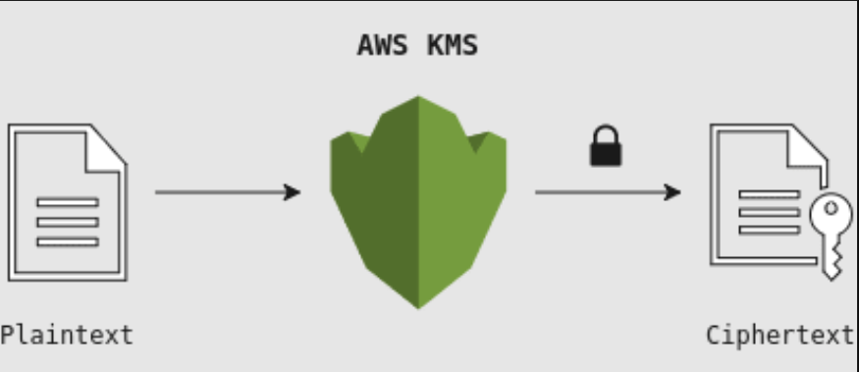
Secure
AWS KMS is designed so that no one, including AWS employees, can get a plaintext key from the service.
This service uses a hardware security module (HSM) that has been validated or is being validated against FIPS 1402 to protect the confidentiality and integrity of the key.
The plaintext key is never written to disk and is used by the HSM's volatile storage for the time required to perform the requested encryption operation.
This is true whether you ask AWS KMS to create the key for you, import it into the service, or use the custom key storage facility to create the key in your AWS CloudHSM cluster.
Credit: https://aws.amazon.com/kms/
Notes:
Reference for contents : https://aws.amazon.com/kms/
More explanation:
Keys created by the AWS KMS service are never transferred outside the AWS region in which they were created, and can only be used in the region in which they were created.
AWS KMS HSM firmware updates are managed by multi-party access controls audited and validated by independent groups within Amazon and FIPS 1402 compliant NIST certified laboratories.

Slide 11
Benefits of KSM
Fully managed: AWS KMS enforces permissions to control the durability and physical security of your keys, while defining permissions on how your keys are used to control access to encrypted data.
Centralized key management: AWS KMS provides a single point of control for managing keys and consistently defining policies across integrated AWS services and your own applications.
Digitally signed data: With AWS KMS, you can use asymmetric key pairs to perform digital signature operations to ensure data integrity. Recipients of digitally signed data can verify the signature regardless of whether they have an AWS account.
Encrypt data in your application: AWS KMS is integrated with the AWS Encryption SDK, so your application can encrypt locally using a KMS-protected data encryption key. You can also use a simple API to incorporate encryption and key management into your own application, regardless of where it runs.
Notes:
Reference for contents : https://aws.amazon.com/kms/
More explanation:
Low cost: There are no commitments or prepayments to use AWS KMS. You only pay $ 1 a month to save the key you created. AWS managed keys created by AWS Services on your behalf can be stored for free. If you use or manage your key beyond the free tier, you will be charged for each request.
Secure: AWS KMS uses a hardware security module (HSM) that has been validated or is being validated against FIPS 1402 to generate and protect keys. The key is used only within these devices and cannot be left unencrypted. KMS keys are never shared outside the AWS Region in which they were created.

Slide 12
Secrets Manager
Overview:
AWS Secrets Manager helps you protect the secrets you need to access your applications, services, and IT resources.
This service makes it easy to rotate, manage, and retrieve database credentials, API keys, and other secrets throughout your life cycle.
Users and applications call the Secrets Manager API to get secrets without having to hard-code sensitive information in plain text.
Secrets Manager provides secret rotation with built-in integration for Amazon RDS, Amazon Redshift, and Amazon DocumentDB.
This service can be extended to other types of secrets, including API keys and OAuth tokens.
In addition, Secrets Manager allows you to use fine-grained permissions to control access to your secrets and centrally monitor the secret rotation of your AWS cloud, third-party services, and on-premises resources.
Notes:
Reference for contents : https://aws.amazon.com/secrets-manager/
More explanation:
Benefits:
Rotate secrets safely
Manage access with fine grained policies
Secure and audit secured centrally
Pay as you go
Easily replicate secrets to multiple region

Slide 13
Features of secrets manager
Secure secrets storage:
Encrypt the secrets using encryption keys stored in KMS
It also decrypts the secret and transmits it by local mode
It does not write the secret in persistent storage
Secrets can be tagged individually
Automatic secrets rotation without disrupting applications:
Secrets can be rotated on schedules
It uses secret manager console for rotation
Secret manager consoles are AWS, SDK, AWS CLI
Notes:
Reference for contents : https://aws.amazon.com/secrets-manager/
More explanation:
You can extend SecretsManager to rotate other secrets by modifying the sample Lambda function
Users and applications get the secret by replacing the hard-coded secret with a call to the Secrets Manager API. This allows you to automate secret rotation while ensuring that your application runs uninterrupted.

Slide 14
Features of secrets manager(Conti.)
3. Automatic replication of secrets to multiple AWS Regions:
Secrets can be replicated automatically in multiple AWS region
You can specify your AWS region using the Secrets Manager console, AWS SDKs, AWS CLI, or AWS CloudFormation.
Programmatic retrieval secrets:
You can store and retrieve secrets and techniques the usage of the AWS Secrets Manager console, AWS SDK, AWS CLI, or AWS CloudFormation.
Secrets Manager provides code samples to call Secrets Manager APIs,
You can configure Amazon Virtual Private Cloud (VPC) endpoints to keep traffic between your VPC and Secrets Manager within the AWS network.
Notes:
Reference for contents : https://aws.amazon.com/secrets-manager/
More explanation:
5. Audit and monitor secret usage:
AWS Secrets Manager allows you to audit and monitor your secrets through integration with AWS logging, monitoring, and notification services.
For example, after you enable AWS CloudTrail in your AWS region, you can view the AWS CloudTrail logs to see when your secrets are saved or rotated.

Slide 15
VPC Network Security Features
Amazon Virtual Private Cloud (VPC) is a service that allows you to launch AWS resources into a defined, logically isolated virtual network.
You have full control over your virtual network environment, including choosing your own IP address range, creating subnets, and configuring route tables and network gateways.
You can use both IPv4 and IPv6 for most resources in your VPC to ensure secure and easy access to your resources and applications.
Amazon VPC makes it easy to customize your VPC's network configuration.
You can create a publicly accessible subnet for a web server that has access to the Internet.
Notes:
Reference for contents : https://aws.amazon.com/vpc/features/
More explanation:
You can also place back-end systems such as databases and application servers on private subnets that do not have internet access.
With Amazon VPC, you can use multiple layers of security, such as security groups and network access control lists, to control access to your Amazon Elastic Compute Cloud (Amazon EC2) instances on any subnet.

Slide 16
Features of VPC Network Security
1. Flow logs: Monitor VPC flow logs delivered to Amazon Simple Storage Service (Amazon S3).
The enhanced metadata in the flow log helps you learn more about the user who initiated the TCP connection and the packet-level sources and destinations of traffic passing through the middle tier (such as NAT gateways).
You can also archive the flow logs to meet specific compliance requirements.
2. IP Adress Manager: IPAM makes it easy to plan, track, and monitor the IP addresses of your AWS workloads.
IPAM automates the assignment of IP addresses to Amazon VPCs, eliminating the need to use homemade or spreadsheet-based scheduling applications.
It also improves network observability by displaying IP utilization across multiple accounts and VPCs in an integrated operational view.
Notes:
Reference for contents : https://aws.amazon.com/vpc/features/
More explanation:
IP Addressing: IP addresses communicate with each other in VPC and communicate with resources through the Internet.
Amazon VPC supports both IPv4 and IPv6 addressing protocols.
In VPC, you can create IPv4ONLY, dual stack, and IPv6ON subnet, and launch Amazon EC2 instances in these subnets.
Amazon also has multiple options for assigning public IP addresses. Amazon's public IPv4 address, elastic IPv4 address, or Amazon's IPv6 CIDRS IP address can be used.
Apart from that, you can assign your own IPv4 or IPv6 address to Amazon VPC that can be assigned to these instances. Learn more about IP addresses in your VPC.

Slide 17
Features of VPC Network Security(CONT.)
Ingress routing: This feature allows you to route all inbound and outbound traffic to and from your Internet gateway or virtual private gateway to the elastic network interface of a particular Amazon EC2 instance.
Configure your virtual private cloud to send all traffic to your gateway or Amazon EC2 instance before it reaches your business workload.
Network Accsess Analyzer: The Network Access Analyzer helps you ensure that your network on AWS meets your network security and compliance requirements.
You can use the Network Access Analyzer to specify network security and compliance requirements and identify inadvertent network access that does not meet the specified requirements.
You can use the Network Access Analyzer to understand network access to your resources, identify improvements to your cloud security regime, and easily show compliance.
Notes:
Reference for contents : https://aws.amazon.com/vpc/features/
More explanation:
6. Network Access Control List: Network access control lists (network ACLs) are an optional security layer
You can configure network ACLs using rules similar to those in security groups. Learn more about the differences between security groups and network ACLs.

Slide 18
Features of VPC Network Security(CONT.)
Reachability Analyzer: You can use this static configuration analysis tool to analyze and debug the network reachability between two resources in your VPC.
After specifying the source and target resources, the Reachability Analyzer creates hop-by-hop details for the virtual path between them if they are reachable, and identifies the blocking component if they are unreachable.
Security Groups: Create a security group that acts as a firewall for your associated Amazon EC2 instances to control inbound and outbound traffic at the instance level.
When you launch an instance, you can associate it with one or more security groups.
If you don't specify a group, the instance is automatically associated with the VPC's default group. Each instance of a VPC can belong to a different set of groups.
Notes:
Reference for contents : https://aws.amazon.com/vpc/features/
More explanation:
Traffic mirroring: You can use this feature to copy network traffic from an Amazon EC2 instance's elastic network interface and send it to an out-of-band security and monitoring appliance for deep packet inspection. You can detect network and security anomalies, gain operational insights, implement compliance and security controls, and troubleshoot issues.
Traffic mirroring gives you direct access to network packets flowing through your VPC.

Slide 19
EMR Security
Overview:
Cloud security is AWS's top priority.
AWS customers benefit from data center and network architectures designed to meet the needs of security-sensitive organizations.
Security is a shared responsibility between AWS and you.
1. Cloud Security:
AWS is responsible for protecting the infrastructure that runs AWS services in the AWS cloud.
AWS also offers services that you can use safely.
Third-party auditors regularly test and verify security effectiveness as part of their AWS compliance program.
.
Notes:
Reference for contents : https://docs.aws.amazon.com/emr/latest/ManagementGuide/emr-security.html
More explanation:
2. Cloud Security:
Customer responsibilities are determined by the AWS services you use.
We are also responsible for other factors such as information confidentiality, business needs, applicable laws and regulations

Slide 20
EMR Security(CONT)
Security Configuration:
Amazon EMR security settings are templates for various security settings.
You can create a security configuration to reuse security settings when you create a cluster.
Data protection:
You can implement data encryption to protect data stored in Amazon S3, data stored in cluster instance storage, and data in transit.
Kerberos:
You can configure Kerberos to provide strong authentication via secret key encryption.
Notes:
Reference for contents : https://docs.aws.amazon.com/emr/latest/ManagementGuide/emr-security.html
More explanation:
Amazon EC2 security groups:
Security groups act as virtual firewalls for EMR cluster instances, limiting inbound and outbound network traffic.

Slide 21
EMR Security(CONT)
Secure EMR with encryption:
Amazon EMR uses Security Configuration to simplify the provision of encryption keys and certificates, from the AWS Key Management Service to the provision of your own provider of custom encryption materials.
Create a security configuration that specifies encryption settings and use that configuration when you create the cluster.
This makes it easy to create a security configuration once and use it in any number of clusters.
Different phases where data needs to be encrypted:
Data at rest
Data in transit
Notes:
Reference for contents : https://docs.aws.amazon.com/emr/latest/ManagementGuide/emr-security.html
More explanation:

Slide 22
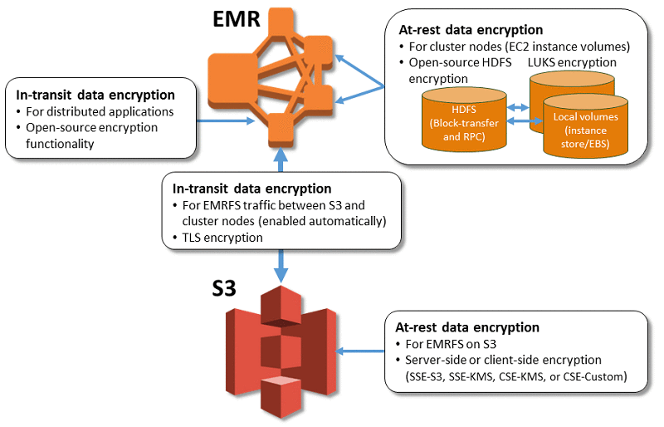
EMR Security(CONT)
Data at Rest:
Data residing on Amazon S3-S3 client-side encryption with EMR
Data that resides on disk – Amazon EC2 instance storage volumes (excluding boot volumes) and connected Amazon EBS volumes for cluster instances are encrypted using the Linux Unified Key System (LUKS)
Data in Transit:
Data in transit from EMR to S3 and vice versa-S3 client-side encryption with EMR
Credit: https://docs.aws.amazon.com/emr/latest/ManagementGuide/emr-security.html
Notes:
Reference for contents : https://docs.aws.amazon.com/emr/latest/ManagementGuide/emr-security.html
More explanation:
Data in transit between nodes in the cluster-Encryption in transit using SecureSocketsLayer (SSL) for MapReduce and SimpleAuthentication and Security Layer (SASL) for SparkShuffle encryption.
Data transferred or cached to disk during the shuffle phase-Spark shuffle encryption or LUKS encryption

Slide 23
Redshift Security
Amazon Redshift database security is different from other types of Amazon Redshift security. In addition to the database security described in this section, Amazon Redshift provides the following security management features:
Sign in credential:
Access to the Amazon Redshift AWS Management Console is controlled by your AWS account permissions.
Access Management :
​​To control access to specific Amazon Redshift resources, define an AWS Identity and Access Management (IAM) account.
Cluster Security Group :
To give other users inbound access to your Amazon Redshift cluster, define a cluster security group and associate it with your cluster.
Notes:
Reference for contents: https://www.google.com/aclk?sa=L&ai=DChcSEwjBxeuVgYD3AhXjbG8EHYzHBloYABACGgJqZg&ae=2&sig=AOD64_3iaSH0knCo76QTQohLwrXgwGTHEQ&q&adurl&ved=2ahUKEwjzmeSVgYD3AhWaKs0KHQdiC4AQ0Qx6BAgCEAE
More explanation:
VPC :
You can launch your cluster in an Amazon Virtual Private Cloud (VPC) to protect access to your cluster using a virtual network environment.

Slide 24
Redshift Security(CONT)
5. SSL Connections:
You can use Secure Sockets Layer (SSL) encryption to encrypt the connection between the SQL client and the cluster.
6. Load Data Encryption :
You can use either server-side encryption or client-side encryption to encrypt the spreadsheet load data file when uploading to Amazon S3.
When loading from server-side encrypted data, Amazon S3 handles decryption transparently.
If you are loading client-side encrypted data, the Amazon RedshiftCOPY command decrypts the data when the table is loaded.
7. Data in transit :
To protect the data in transit within the AWS cloud, Amazon Redshift uses hardware-accelerated SSL to communicate with Amazon S3 or Amazon DynamoDB for copy, unload, backup, and restore operations.
Notes:
Reference for contents: https://www.google.com/aclk?sa=L&ai=DChcSEwjBxeuVgYD3AhXjbG8EHYzHBloYABACGgJqZg&ae=2&sig=AOD64_3iaSH0knCo76QTQohLwrXgwGTHEQ&q&adurl&ved=2ahUKEwjzmeSVgYD3AhWaKs0KHQdiC4AQ0Qx6BAgCEAE
More explanation:
8. Column-Level Access Control :
To perform column-level access control on Amazon Redshift data, you can enable and revoke column-level access without implementing view-based access control or using another system.

Slide 25
Redshift Security(CONT)
Access to Amazon Redshift resources is controlled at four levels:
1. Cluster Management: ​​
The ability to create, configure, and delete clusters is controlled by the permissions granted to the IAM user or account associated with your AWS security credentials.
IAM users with the appropriate permissions can manage their clusters using the AWS Management Console, AWS Command Line Interface (CLI), or Amazon Redshift Application Programming Interface (API). This access is managed using IAM policies.
2. Cluster Connections:
Amazon Redshift security groups specify AWS instances that can connect to your Amazon Redshift cluster in Classless Inter-Domain Routing (CIDR) format.
Notes:
Reference for contents: https://www.google.com/aclk?sa=L&ai=DChcSEwjBxeuVgYD3AhXjbG8EHYzHBloYABACGgJqZg&ae=2&sig=AOD64_3iaSH0knCo76QTQohLwrXgwGTHEQ&q&adurl&ved=2ahUKEwjzmeSVgYD3AhWaKs0KHQdiC4AQ0Qx6BAgCEAE
More explanation:
3. Database Access :
The ability to access database objects such as tables and views is controlled by the Amazon Redshift database user account.
Users can only access resources in the database that the user account is allowed to access. Create these Amazon Redshift user accounts and manage permissions using the CREATE USER, CREATE GROUP, GRANT, and REVOKE SQL statements.

Slide 26
Redshift Security(CONT)
4. Temporary database credentials and single sign-on :
In addition to creating and managing database users using SQL commands such as CREATE USER and ALTER USER, you can configure SQL clients using custom AmazonRedshift JDBC or ODBC drivers.
These drivers manage the process of creating database users and temporary passwords as part of the database login process.
The driver authenticates database users based on AWS Identity and Access Management (IAM) authentication.
If you already manage your user identities outside of AWS, you can use a SAML 2.0-compliant identity provider (IdP) to manage access to your Amazon Redshift resources.
Use the IAM role to configure IdP and AWS to allow federated users to generate temporary database credentials to log in to your Amazon Redshift database.
Notes:
Reference for contents: https://www.google.com/aclk?sa=L&ai=DChcSEwjBxeuVgYD3AhXjbG8EHYzHBloYABACGgJqZg&ae=2&sig=AOD64_3iaSH0knCo76QTQohLwrXgwGTHEQ&q&adurl&ved=2ahUKEwjzmeSVgYD3AhWaKs0KHQdiC4AQ0Qx6BAgCEAE
More explanation:

